Slide 1


AI PERSONALIZED EMAIL GENERATOR

Slide 2


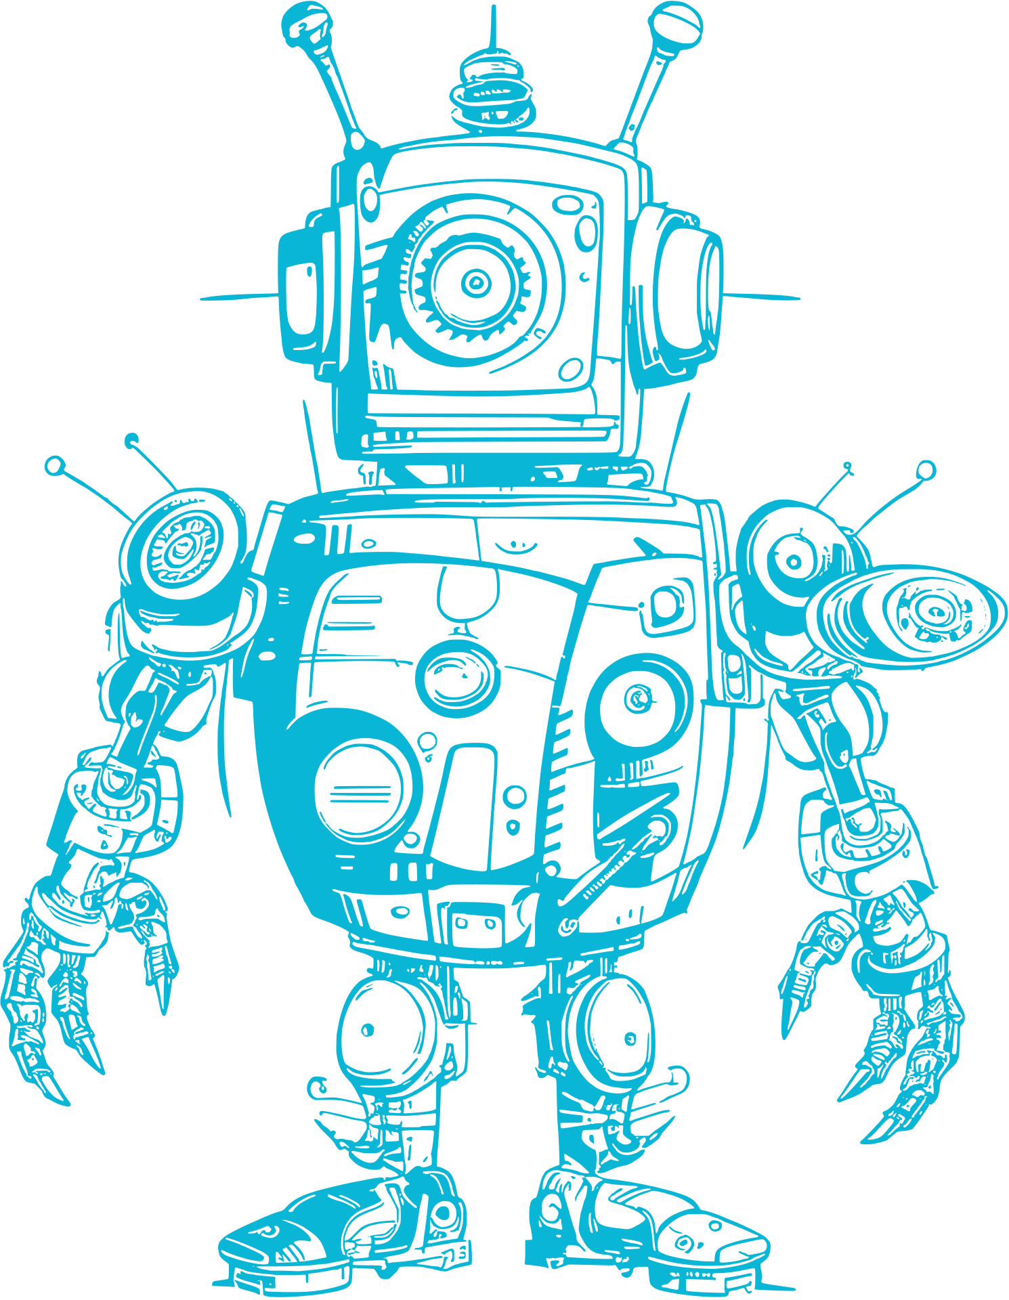

02
ThunderBoltzzz
Project Overview
Develop an AI-Personalized email generator using Gemini Flash to help users in communication which contains various features and writing down message and sending it to the concerned person through email

Slide 3
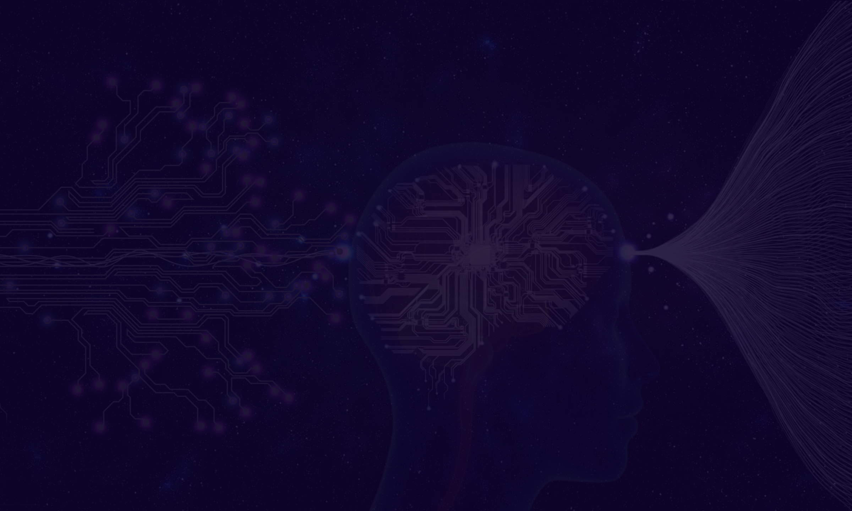

ThunderBoltzzz
Problem Statement
oMany businesses and individuals struggle to craft personalized emails that resonate with their recipients. With the rise of digital communication, email has become an essential tool for marketing, sales, and customer support. However, generic, impersonal emails often end up in spam folders or get deleted without being read.
03

Slide 4

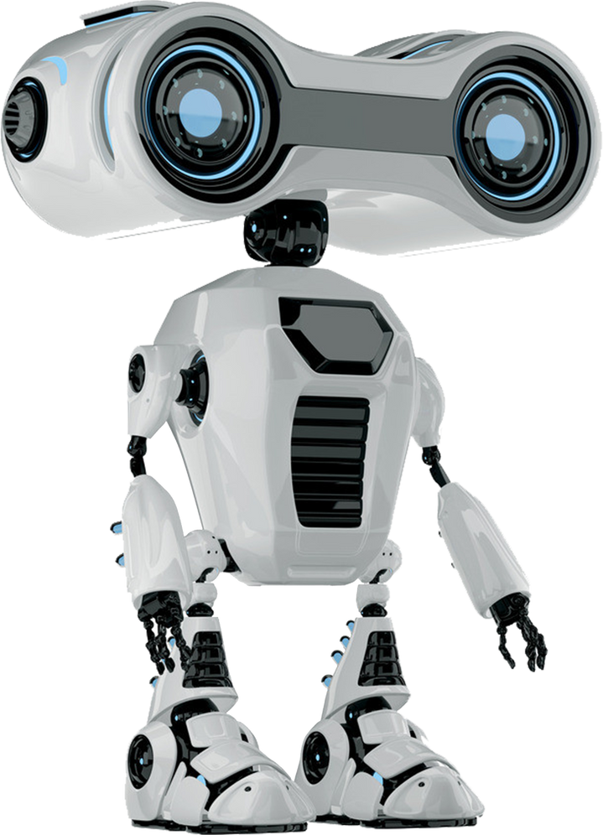
04
ThunderBoltzzz
Requirement Analysis
○Programming Language: Python
○ Backend: Google Gemini Flash API
○ Frontend: Streamlit Web Framework

Slide 5

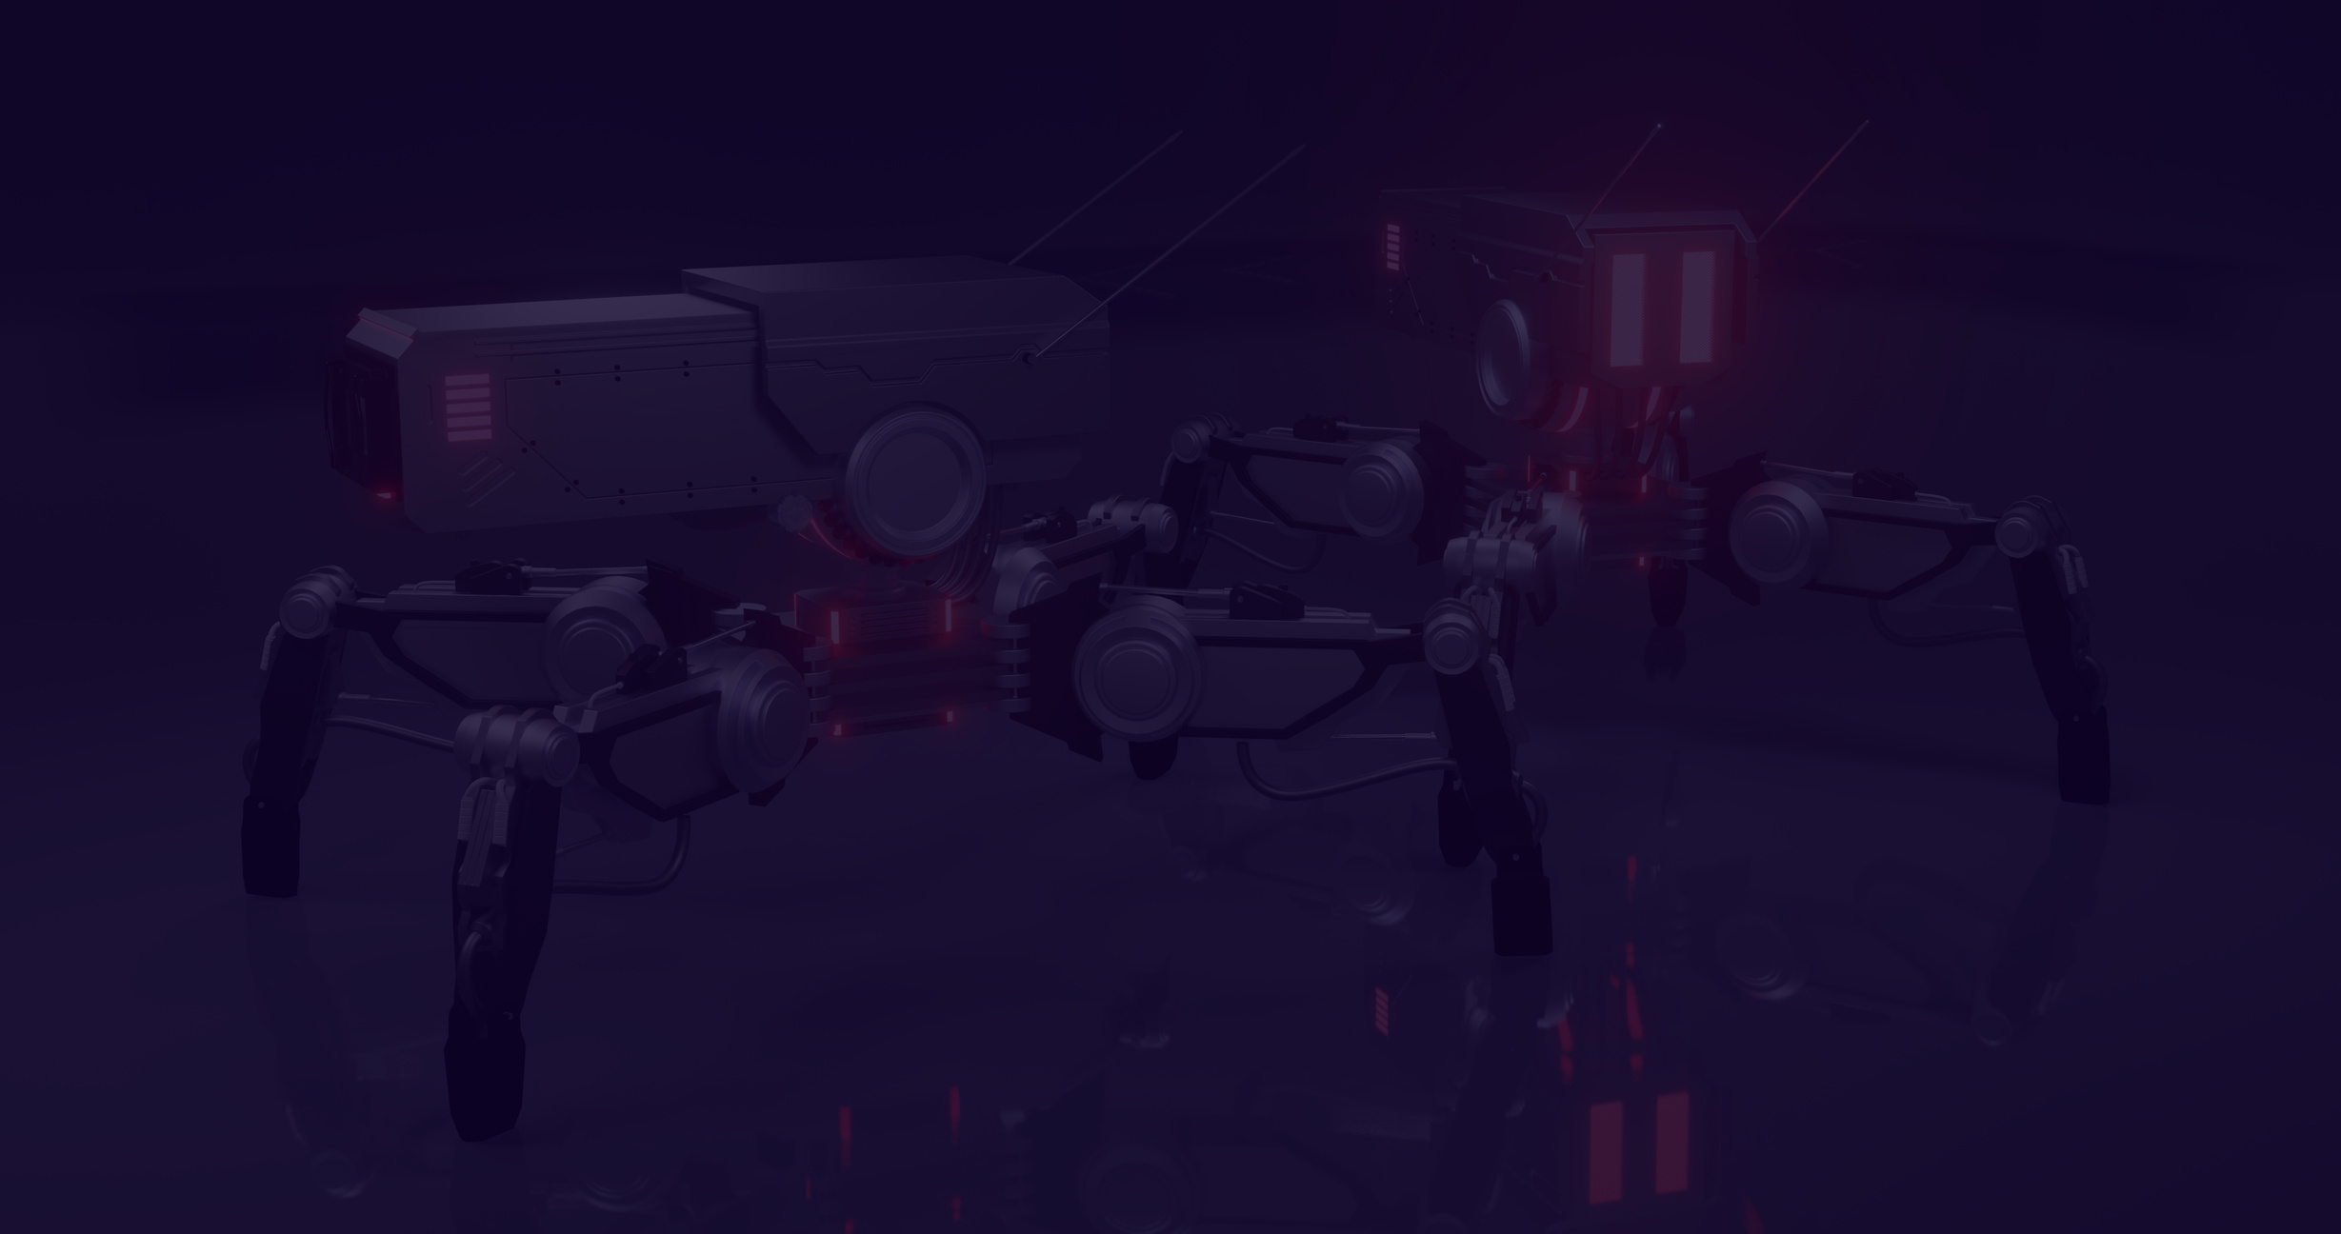

05
ThunderBoltzzz
Plan Of Action For Development
Step 1: Understand What We Want to Achieve
Step 2: Gather Data and Information
Step 3: Choose the Right Tools and Technologies
Step 4: Design the Email Generator System
Step 5: Train the AI ModeL
Step 6: Test and Refine the System
Step 7: Launch and Maintain the System

Slide 6

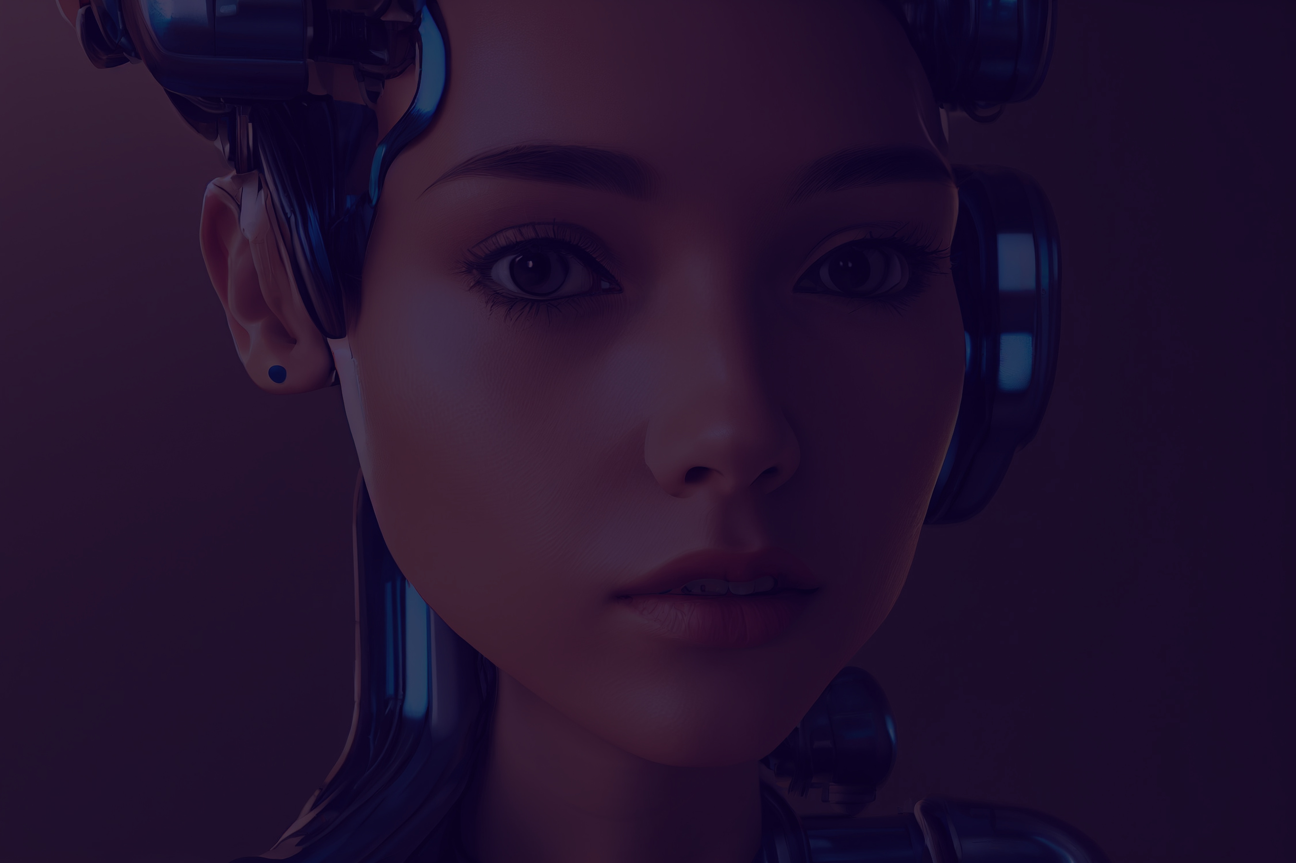
ThunderBoltzzz
CONCLUSION
With AI-driven personalization, this email generator enhances communication, saves time, and optimizes email outreach—making it an indispensable tool for individuals and businesses alike

Slide 7



ThunderBoltzzz
Thank You!

